Slide 1




Multi-language patient health webinar
“Seeing the world through little eyes”
Presented by:
Health Diversity Equity and Inclusion Alliance
Made possible with a generous donation by:
The Bausch Health Foundation
हिन्दी (ऑडियो चलाने के लिए आइकन पर क्लिक करें)
Español (Haz clic en el ícono para reproducir el audio)

Slide 2






HDEIA Mission:
Advance access to health and provide educational resources for underserved populations, promote diversity in clinical trial research and STEM, to contribute to improving healthcare and health care related economy globally.
Empowers Individuals
Helps people understand their health and make informed decisions.
Improves Health Outcomes
Better understanding = better care, fewer complications.
Reduces Health Disparities
Supports equity across diverse populations.
Strengthens Public Health
Increases trust, compliance, and crisis response.
Visit us at
www.HDEIA.org
हिन्दी (ऑडियो चलाने के लिए आइकन पर क्लिक करें)
Español (Haz clic en el ícono para reproducir el audio)
Notes:
Health literacy isn’t just about reading pamphlets—it’s about helping people understand their care, manage chronic conditions, and prevent serious illness. This matters even more in vulnerable communities where language, education, and access can be barriers.And when people understand their health, they engage earlier, make better decisions, and reduce strain on the system. Ultimately, health literacy is a tool for empowerment and equity.

Slide 3

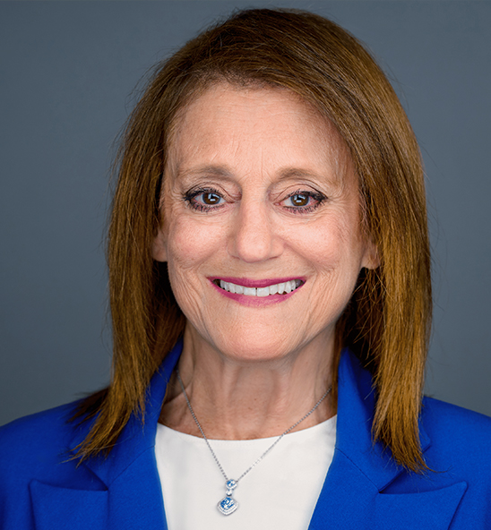

Our Speaker
Dr.Susan Resnick is a co-managing partner in a New York City and Long Island based private specialty group contact lens practice which she joined upon graduation from SUNY in 1983. She is an Administrator in the Vision Source Network. She is a Diplomate in both the Cornea and Contact Lens Section of the American Academy of Optometry and the American Board of Optometry. She is a Fellow of the Scleral Lens Education Society.
Dr.Resnick is the Editor in Chief of the Clinical and Refractive Optometry Journal as well as a contributing editorial advisor to Optometric Management and contributor to Contact Lens Spectrum. She is frequently invited speaker on specialty contact lenses and practice management She has received numerous awards for her expertise in clinical care and mentorship.
Sincere thanks to Dr.Susan Resnick of Drs.Farkas, Kassalow, Resnick and Associates
Dr. Susan Resnick, O.D., F.A.A.O
हिन्दी (ऑडियो चलाने के लिए आइकन पर क्लिक करें)
Español (Haz clic en el ícono para reproducir el audio)

Slide 4



Outline
Common eye problems
How to care for the little eyes?
Q and A
हिन्दी (ऑडियो चलाने के लिए आइकन पर क्लिक करें)
Español (Haz clic en el ícono para reproducir el audio)

Slide 5

Seeing the World Through Little Eyes What we need to know
हिन्दी (ऑडियो चलाने के लिए आइकन पर क्लिक करें)
Español (Haz clic en el ícono para reproducir el audio)

Slide 6
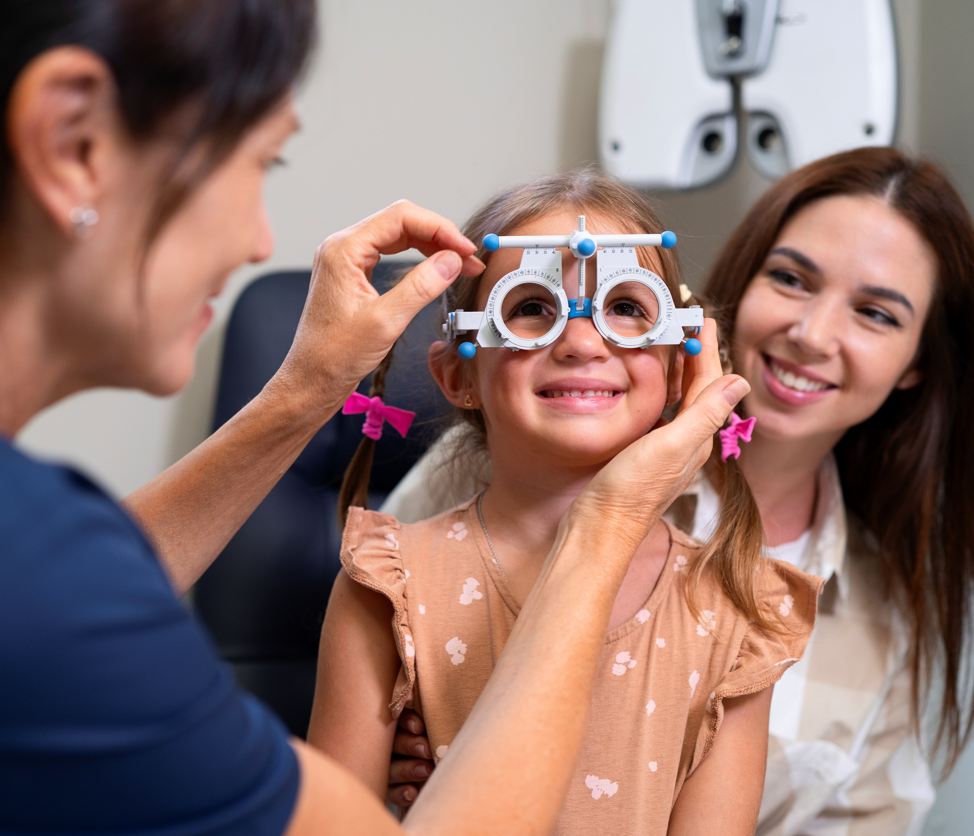

A Parents and Caregivers Guide to Common Eye Problems in Kids
Every child’s eyes are precious — they help them explore, learn, and dream.
Sometimes, little eyes need extra care to stay healthy and strong.
Let’s learn how to spot common problems early — so kids never miss a moment!
हिन्दी (ऑडियो चलाने के लिए आइकन पर क्लिक करें)
Español (Haz clic en el ícono para reproducir el audio)

Slide 7
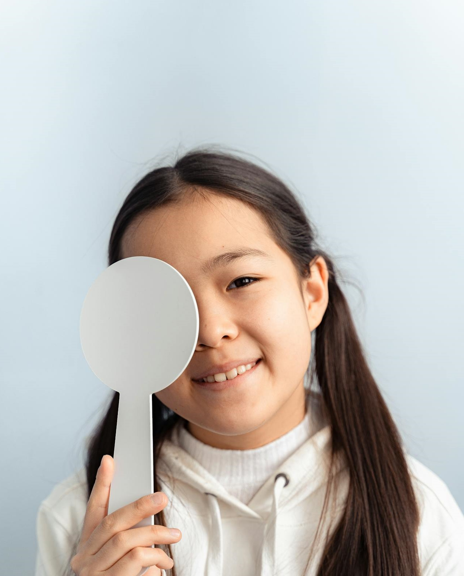
Healthy Eyes, Happy Kids!
Clear vision means kids can see the smiles they love and the world they’re curious about.
Many childhood eye problems are easy to treat if we catch them early.
You know your child best — trust your eyes to protect theirs!
Together, we can help every child see their bright future.
हिन्दी (ऑडियो चलाने के लिए आइकन पर क्लिक करें)
Español (Haz clic en el ícono para reproducir el audio)

Slide 8



Eyes on Health:
Common Vision Problems in Kids
Vision Problems (Refractive Errors)
            Myopia (Nearsightedness)
            Hyperopia (Farsightedness)
            Astigmatism
Eye Alignment Issues
  Strabismus (Crossed Eyes)
  Amblyopia (Lazy Eye)
Movement disorder
  Nystagmus
Eye Infections and Inflammation
Pink Eye (Conjunctivitis)
Viral Conjunctivitis
Bacterial Conjunctivitis
Allergic Conjunctivitis
Stye (Hordeolum)
Others
Ptosis (Droopy Eyelid)
Cataract (Cloudy Eye)
Blocked Tear Duct
हिन्दी (ऑडियो चलाने के लिए आइकन पर क्लिक करें)
Español (Haz clic en el ícono para reproducir el audio)

Slide 9
Blurry Vision (Refractive Errors)
Problems with how the eye focuses light, causing blurry vision.
Common types:
Nearsightedness (Myopia): trouble seeing far away
Farsightedness (Hyperopia): trouble seeing up close
Astigmatism: blurry or distorted vision at any distance
हिन्दी (ऑडियो चलाने के लिए आइकन पर क्लिक करें)
Español (Haz clic en el ícono para reproducir el audio)
Notes:
References:
Donahue SP. Refractive errors in children. Pediatr Clin North Am. 2012;59(1):117-28. PMID: 22265474
Hashemi H, Fotouhi A, Yekta A, et al. Global and regional estimates of prevalence of refractive errors: systematic review and meta-analysis. J Curr Ophthalmol. 2020;32(1):3-16. PMID: 32111135

Slide 10
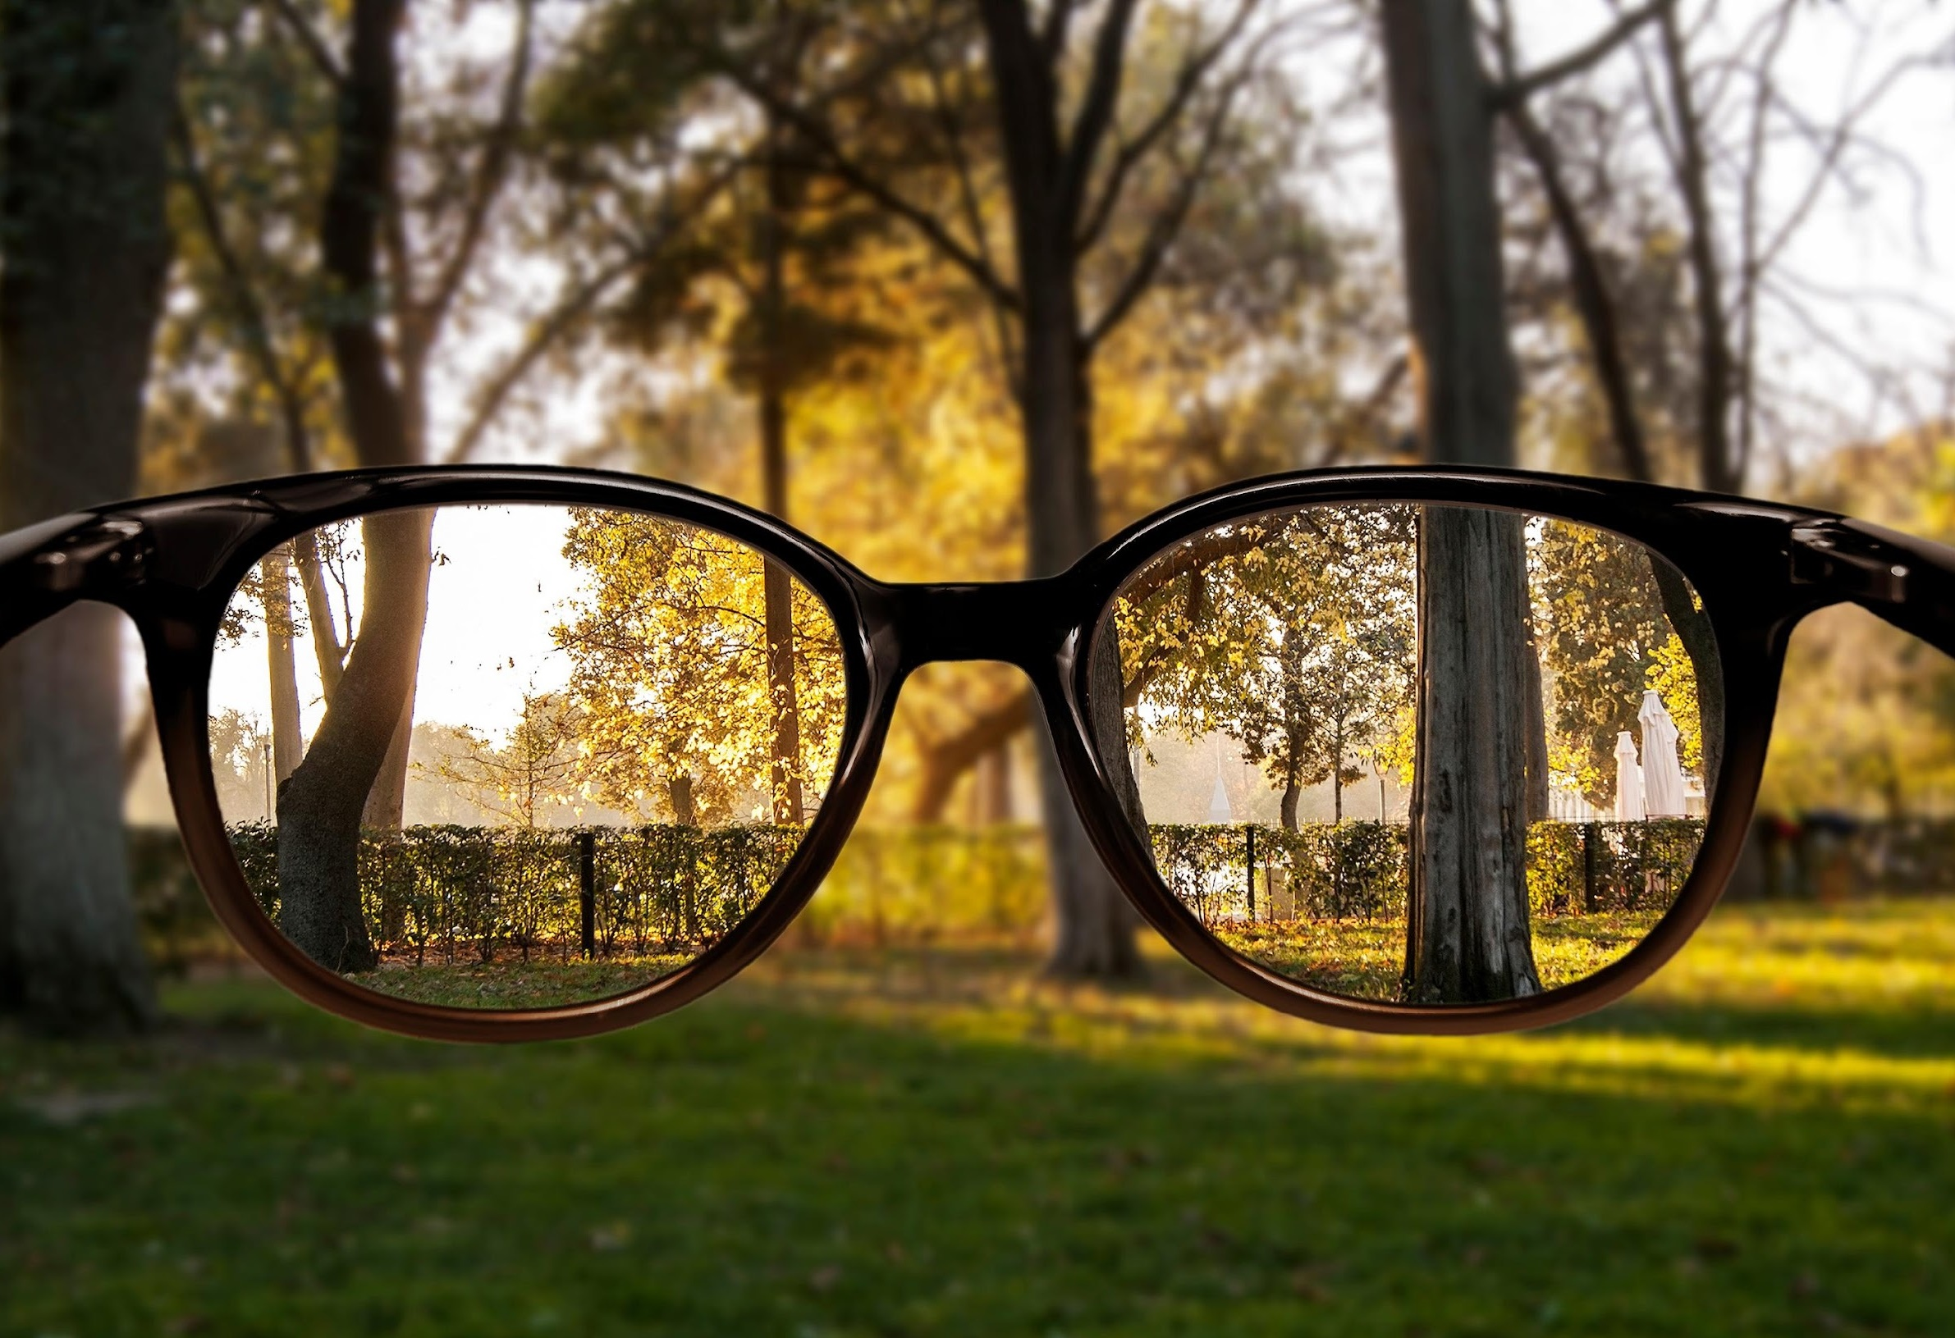
Nearsightedness (Myopia)
Difficulty seeing objects clearly at a distance.
Classroom board looks blurry.
Signs:
Squinting to see distant objects.
Trouble reading signs or watching TV clearly.
Myopia Control:
Prescription glasses or contact lenses.
Vision therapy or corrective surgery for older children if needed.
हिन्दी (ऑडियो चलाने के लिए आइकन पर क्लिक करें)
Español (Haz clic en el ícono para reproducir el audio)
Notes:
References:
Morgan IG, Ohno-Matsui K, Saw S-M. Myopia. Lancet. 2012;379(9827):1739-48. PMID: 22424757
Donahue SP. Refractive errors in children. Pediatr Clin North Am. 2012;59(1):117-28. PMID: 22265474

Slide 11

Farsightedness (Hyperopia)
Difficulty seeing things up close.
Words in books look blurry.
Signs:
Eye strain or headaches when reading or doing close work.
Trouble focusing on nearby objects.
Treatment:
Prescription glasses or contact lenses.
Vision therapy if recommended.
हिन्दी (ऑडियो चलाने के लिए आइकन पर क्लिक करें)
Español (Haz clic en el ícono para reproducir el audio)
Notes:
References:
Donahue SP. Refractive errors in children. Pediatr Clin North Am. 2012;59(1):117-28. PMID: 22265474Maples WC. Clinical experience with vision therapy in adults with convergence insufficiency. Optometry. 1991;62(6):354-62. PMID: 1946908

Slide 12
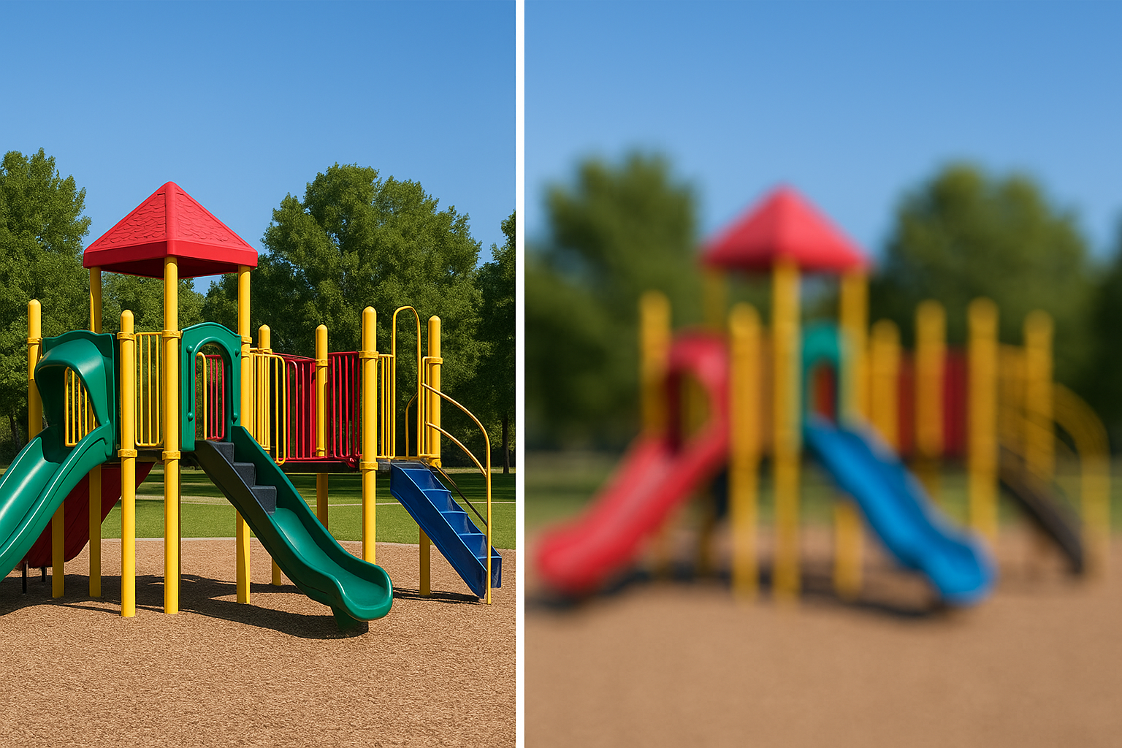
Astigmatism
Blurry or distorted vision at any distance.
Caused by an irregularly shaped cornea (like a football, not round).
Signs:
Seeing wavy or blurry images
Eye strain or headaches
Treatment:
Prescription glasses or contact lenses
Sometimes vision therapy or surgery for older children
हिन्दी (ऑडियो चलाने के लिए आइकन पर क्लिक करें)
Español (Haz clic en el ícono para reproducir el audio)
Notes:
References:
Donahue SP. Refractive errors in children. Pediatr Clin North Am. 2012;59(1):117-28. PMID: 22265474
Pärssinen O, Lyyra AL. Astigmatism and myopia progression in children. Invest Ophthalmol Vis Sci. 1993;34(3):643-7. PMID: 8440711

Slide 13
Lazy Eye (Amblyopia)
Lazy Eye?
One eye doesn’t see as well.
The brain uses the strong eye more.
Why does it happen?
It can happen if one eye is blurry or turns in/out.
What Does Lazy Eye Look Like?
One eye might drift in, out, up, or down.
हिन्दी (ऑडियो चलाने के लिए आइकन पर क्लिक करें)
Español (Haz clic en el ícono para reproducir el audio)
Notes:
References:
Holmes JM, Clarke MP. Amblyopia. Lancet. 2006;367(9519):1343–51. PMID: 16631911
PEDIG. A Randomized Trial of Patching Regimens for Moderate Amblyopia. Arch Ophthalmol. 2003;121(5):603–11. PMID: 12742838

Slide 14
Lazy Eye (Amblyopia)
Treatment:
Eye muscles don’t work together.
Glasses help eyes focus better.
Eye patches help the weak eye get stronger.
Special eye games (vision therapy).
Sometimes doctors do surgery to fix the eye muscles.
हिन्दी (ऑडियो चलाने के लिए आइकन पर क्लिक करें)
Español (Haz clic en el ícono para reproducir el audio)
Notes:
References:
Huang D, Chen X, Wang J, et al. (2025). Non-surgical treatment of strabismus in children: A review. PubMed ID: 40655112AAO – Preferred Practice Pattern® Panel (2022). Pediatric Eye Evaluations PPP: Strabismus. PMC ID: PMC10655158Dembinski R, et al. (2019). Outcomes following surgery for horizontal strabismus in children. PubMed ID: 31184517Holmes JM, et al. (2003). Patching vs. atropine drops for amblyopia. PubMed ID: 12719684Feuillade C, et al. (2023). Strabismus surgery and learning in children. PubMed ID: 36691981

Slide 15
Crossed Eyes (Strabismus)
Eyes don’t point the same way.
Why Does It Happen?
Eye muscles don’t work together.
Can We Tell?
One eye looks away.
May see double.
Kids may tilt their head to see better.
हिन्दी (ऑडियो चलाने के लिए आइकन पर क्लिक करें)
Español (Haz clic en el ícono para reproducir el audio)
Notes:
References:
Mohney BG. Ophthalmology. 2007;114(1):170–4. PMID: 17198852
Gunton KB. BMJ. 2015;351:h5684. PMID: 26571264

Slide 16
Crossed Eyes (Strabismus)
Signs:
Squinting
Covering one eye
Bumping into things
Treatment:
Eye patch on the strong eye
Glasses
Sometimes eye drops
हिन्दी (ऑडियो चलाने के लिए आइकन पर क्लिक करें)
Español (Haz clic en el ícono para reproducir el audio)
Notes:
References:
Holmes JM, Clarke MP. Lancet. 2006. PMID: 16631911
PEDIG. Arch Ophthalmol. 2003;121(5):603–11. PMID: 12742838
Repka MX, et al. Arch Ophthalmol. 2004;122(2):246–52. PMID: 14769591

Slide 17
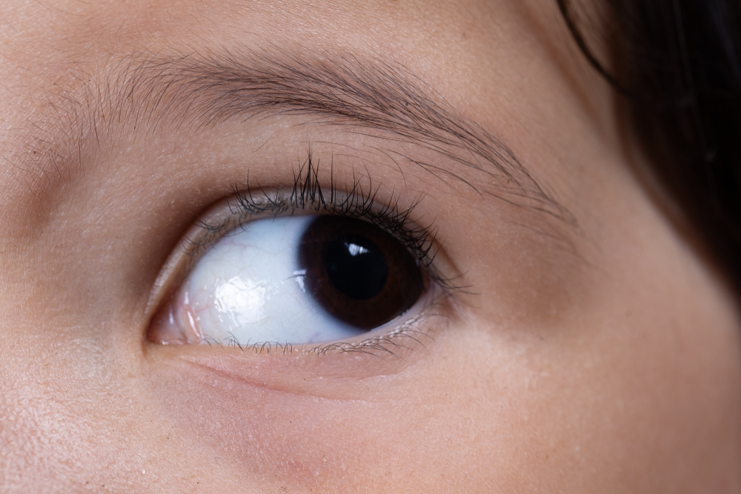
Nystagmus (Eye Shaking)
Eyes move quickly side-to-side or up and down without control.
Nystagmus may be a result of other eye and/or a health problem.
Signs:
Eyes look like they’re “jiggling.”
Kids may tilt their head to help focus.
Treatment:
Glasses may help.
Some kids need special surgery.
हिन्दी (ऑडियो चलाने के लिए आइकन पर क्लिक करें)
Español (Haz clic en el ícono para reproducir el audio)
Notes:
References:
Dell’Osso LF, et al. Nystagmus: an overview. Optom Vis Sci. 2011;88(9):E1100–5. PMID: 21730898

Slide 18

Pink Eye
Also called conjunctivitis.
The thin layer that covers the white part of your eye gets red and swollen.
Causes:
Germs (Virus or Bacteria)
Allergies (Pollen, dust, pets, irritants, etc.)
हिन्दी (ऑडियो चलाने के लिए आइकन पर क्लिक करें)
Español (Haz clic en el ícono para reproducir el audio)
Notes:
References:
Azari & Barney, JAMA, 2013; 310(16):1721–1729. [PMID: 24193039]
Rose & Rietveld, Am Fam Physician, 2016; 94(7):560–566. [PMID: 27929243]
Sheikh & Hurwitz, Cochrane Rev, 2006; (2):CD001211. [PMID: 16625513]
Bielory & Bielory, Curr Opin Allergy Clin Immunol, 2014;14(5):460–467. [PMID: 25003808]

Slide 19
Viral Conjunctivitis
Caused by a virus.
Most common type of pink eye in kids.
Eyes red, watery, and itchy.
Sometimes it happens after you’ve had a cold.
How it spreads:
Very contagious!
Spread by coughing, sneezing, or touching eyes with dirty hands.
It can spread to family or classmates.
हिन्दी (ऑडियो चलाने के लिए आइकन पर क्लिक करें)
Español (Haz clic en el ícono para reproducir el audio)
Notes:
References:
Azari AA, Barney NP. Conjunctivitis: A Systematic Review of Diagnosis and Treatment. JAMA. 2013;310(16):1721-9. PMID: 24193039
Rose PW, Rietveld RP. Conjunctivitis. Am Fam Physician. 2016;94(7):560-6. PMID: 27929243

Slide 20
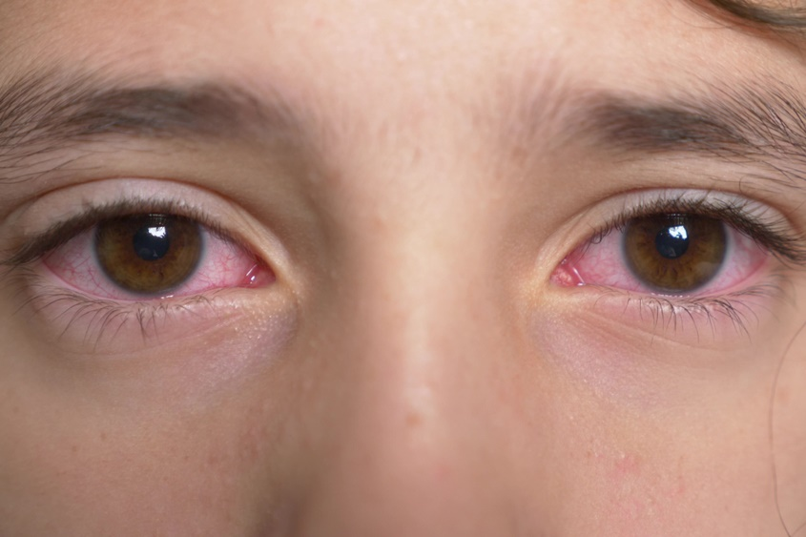
Viral Conjunctivitis
How to treat it:
No medicine - gets better on its own in a few days to a week.
Cool compresses to help
✅ Kid tip: Wash your hands. Don’t touch your eyes!
हिन्दी (ऑडियो चलाने के लिए आइकन पर क्लिक करें)
Español (Haz clic en el ícono para reproducir el audio)
Notes:
References:
Azari AA, Barney NP. Conjunctivitis: A Systematic Review of Diagnosis and Treatment. JAMA. 2013;310(16):1721-9. PMID: 24193039
Rose PW, Rietveld RP. Conjunctivitis. Am Fam Physician. 2016;94(7):560-6. PMID: 27929243

Slide 21
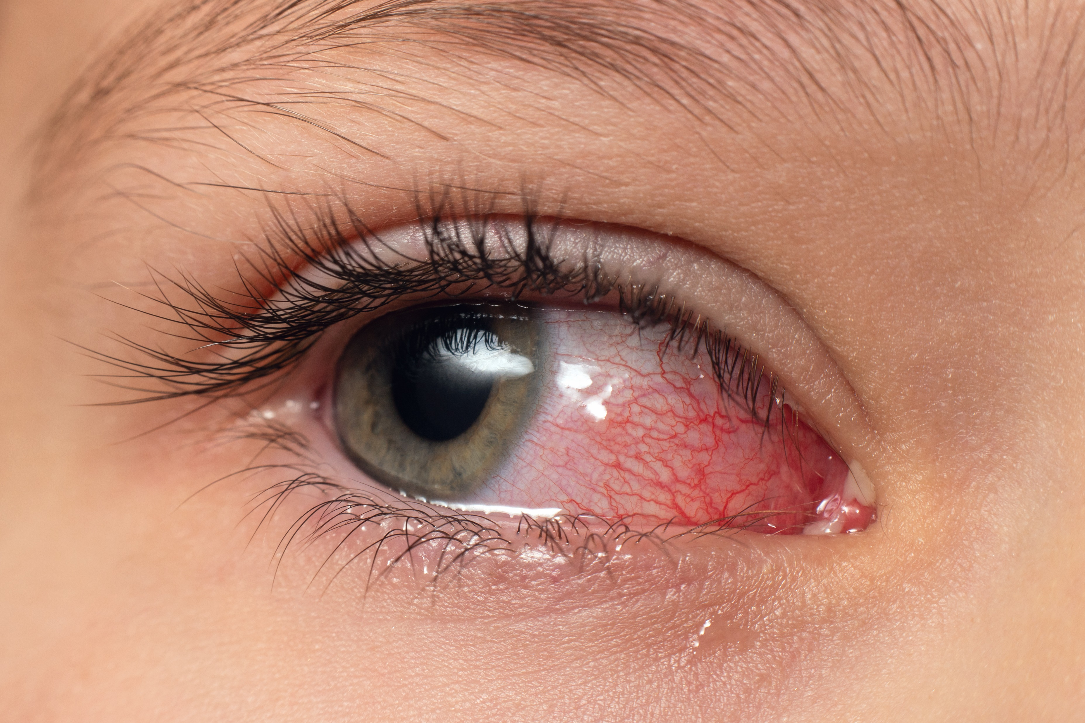
Bacterial Conjunctivitis
Pink eye caused by bacteria (germs).
Eyes red, swollen, sticky, and crusty.
Sometimes your eyelashes stick together when you wake up!
Often starts in one eye and spreads to the other.
How it spreads:
Very contagious!
Spread by touching your eyes, sharing towels, or not washing hands.
हिन्दी (ऑडियो चलाने के लिए आइकन पर क्लिक करें)
Español (Haz clic en el ícono para reproducir el audio)
Notes:
References:
Azari AA, Barney NP. Conjunctivitis: A Systematic Review of Diagnosis and Treatment. JAMA. 2013;310(16):1721-9. PMID: 24193039
Sheikh A, Hurwitz B. Antibiotics versus placebo for acute bacterial conjunctivitis. Cochrane Database Syst Rev. 2006;(2):CD001211. PMID: 16625513

Slide 22
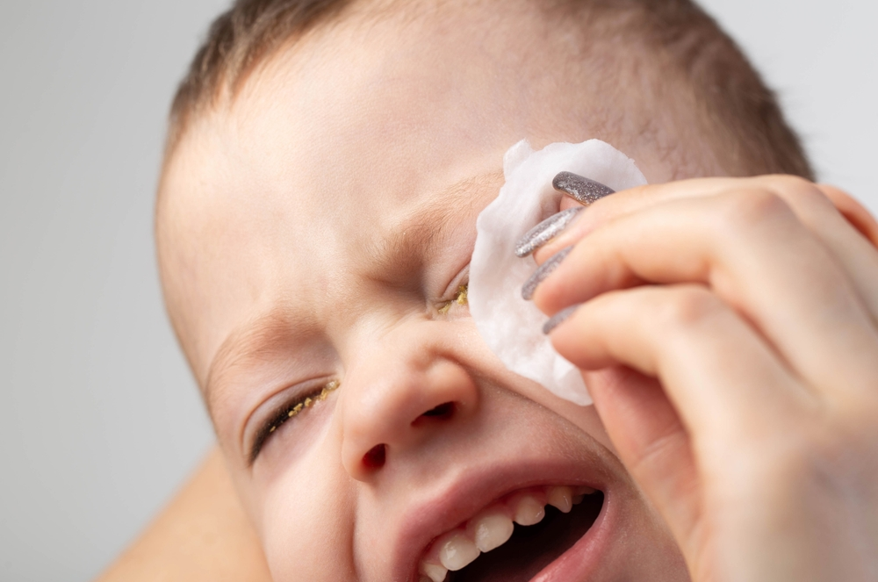
Bacterial Conjunctivitis
Treatment:
Antibiotic eye drops or ointment.
Gets better in a few days with medicine.
✅ Kid tip: Wash your hands and don’t touch or rub your eyes!
हिन्दी (ऑडियो चलाने के लिए आइकन पर क्लिक करें)
Español (Haz clic en el ícono para reproducir el audio)
Notes:
References:
Azari AA, Barney NP. Conjunctivitis: A Systematic Review of Diagnosis and Treatment. JAMA. 2013;310(16):1721-9. PMID: 24193039
Sheikh A, Hurwitz B. Antibiotics versus placebo for acute bacterial conjunctivitis. Cochrane Database Syst Rev. 2006;(2):CD001211. PMID: 16625513

Slide 23

Allergic Conjunctivitis
When your eyes react to pollen, pets, or dust.
NOT spread from person to person.
Signs:
Red, itchy eyes
Watery eyes
Kids rub their eyes may have stuffy nose too
हिन्दी (ऑडियो चलाने के लिए आइकन पर क्लिक करें)
Español (Haz clic en el ícono para reproducir el audio)
Notes:
References:
Bielory L, Bielory BP. Allergic conjunctivitis: update on pathophysiology and prospects for future treatment. Curr Opin Allergy Clin Immunol. 2014;14(5):460-7. PMID: 25003808
Azari AA, Barney NP. Conjunctivitis: A Systematic Review of Diagnosis and Treatment. JAMA. 2013;310(16):1721-9. PMID: 24193039

Slide 24

Allergic Conjunctivitis
Treatment:
Cool compress.
Artificial tears.
Allergy drop (antihistamine) or steroid.
✅ Kid tip: Stay away from what causes allergy.
Wash hands and face after playing outside.
हिन्दी (ऑडियो चलाने के लिए आइकन पर क्लिक करें)
Español (Haz clic en el ícono para reproducir el audio)
Notes:
References:
Bielory L, Bielory BP. Allergic conjunctivitis: update on pathophysiology and prospects for future treatment. Curr Opin Allergy Clin Immunol. 2014;14(5):460-7. PMID: 25003808
Azari AA, Barney NP. Conjunctivitis: A Systematic Review of Diagnosis and Treatment. JAMA. 2013;310(16):1721-9. PMID: 24193039

Slide 25
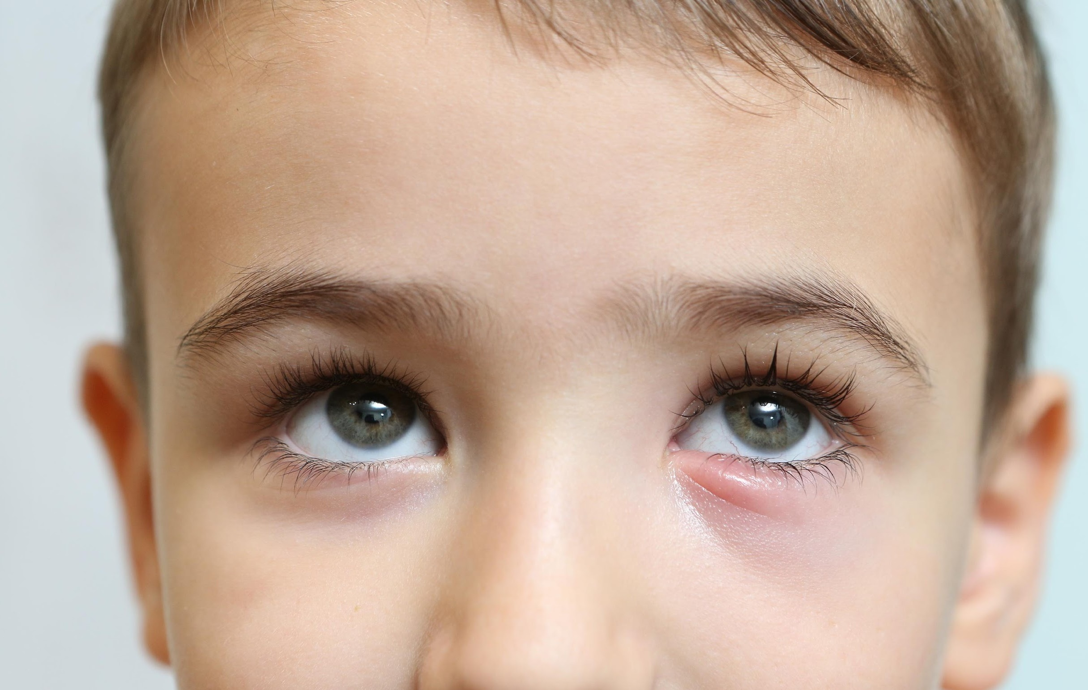
Stye (Hordeolum)
A small red bump on the eyelid (like a pimple).
Caused by a blocked eyelash gland.
Signs:
Swollen, sore eyelid.
Pus or crust.
Treatment:
Warm compress.
Sometimes antibiotic ointment.
हिन्दी (ऑडियो चलाने के लिए आइकन पर क्लिक करें)
Español (Haz clic en el ícono para reproducir el audio)
Notes:
References:
Pinar-Sueiro S, et al. Management of chalazion and hordeolum. Actas Dermosifiliogr. 2012;103(7):629–37. PMID: 22951004

Slide 26

Ptosis (Droopy Eyelid)
Upper eyelid droops down over the eye.
Can block vision if severe.
Signs:
Eyelid covers part of pupil.
Child tilts head back to see better.
Treatment:
May need eyelid surgery if vision is blocked.
हिन्दी (ऑडियो चलाने के लिए आइकन पर क्लिक करें)
Español (Haz clic en el ícono para reproducir el audio)
Notes:
References:
Finsterer J. Ptosis: causes, presentation, and management. Aesthetic Plast Surg. 2003;27(3):193–204. PMID: 14504780

Slide 27

Cloudy Eye (Cataract)
The lens inside the eye is cloudy.
What Causes Cataracts in Kids?
Some babies are born with it.
Others get it from an injury.
हिन्दी (ऑडियो चलाने के लिए आइकन पर क्लिक करें)
Español (Haz clic en el ícono para reproducir el audio)
Notes:
References:
Nihalani BR, Clin Ophthalmol. 2011; PMID: 21845084
Haargaard B, Acta Ophthalmol. 2016; PMID: 26666166
Wilson ME, Community Eye Health. 2003; PMID: 17491934

Slide 28
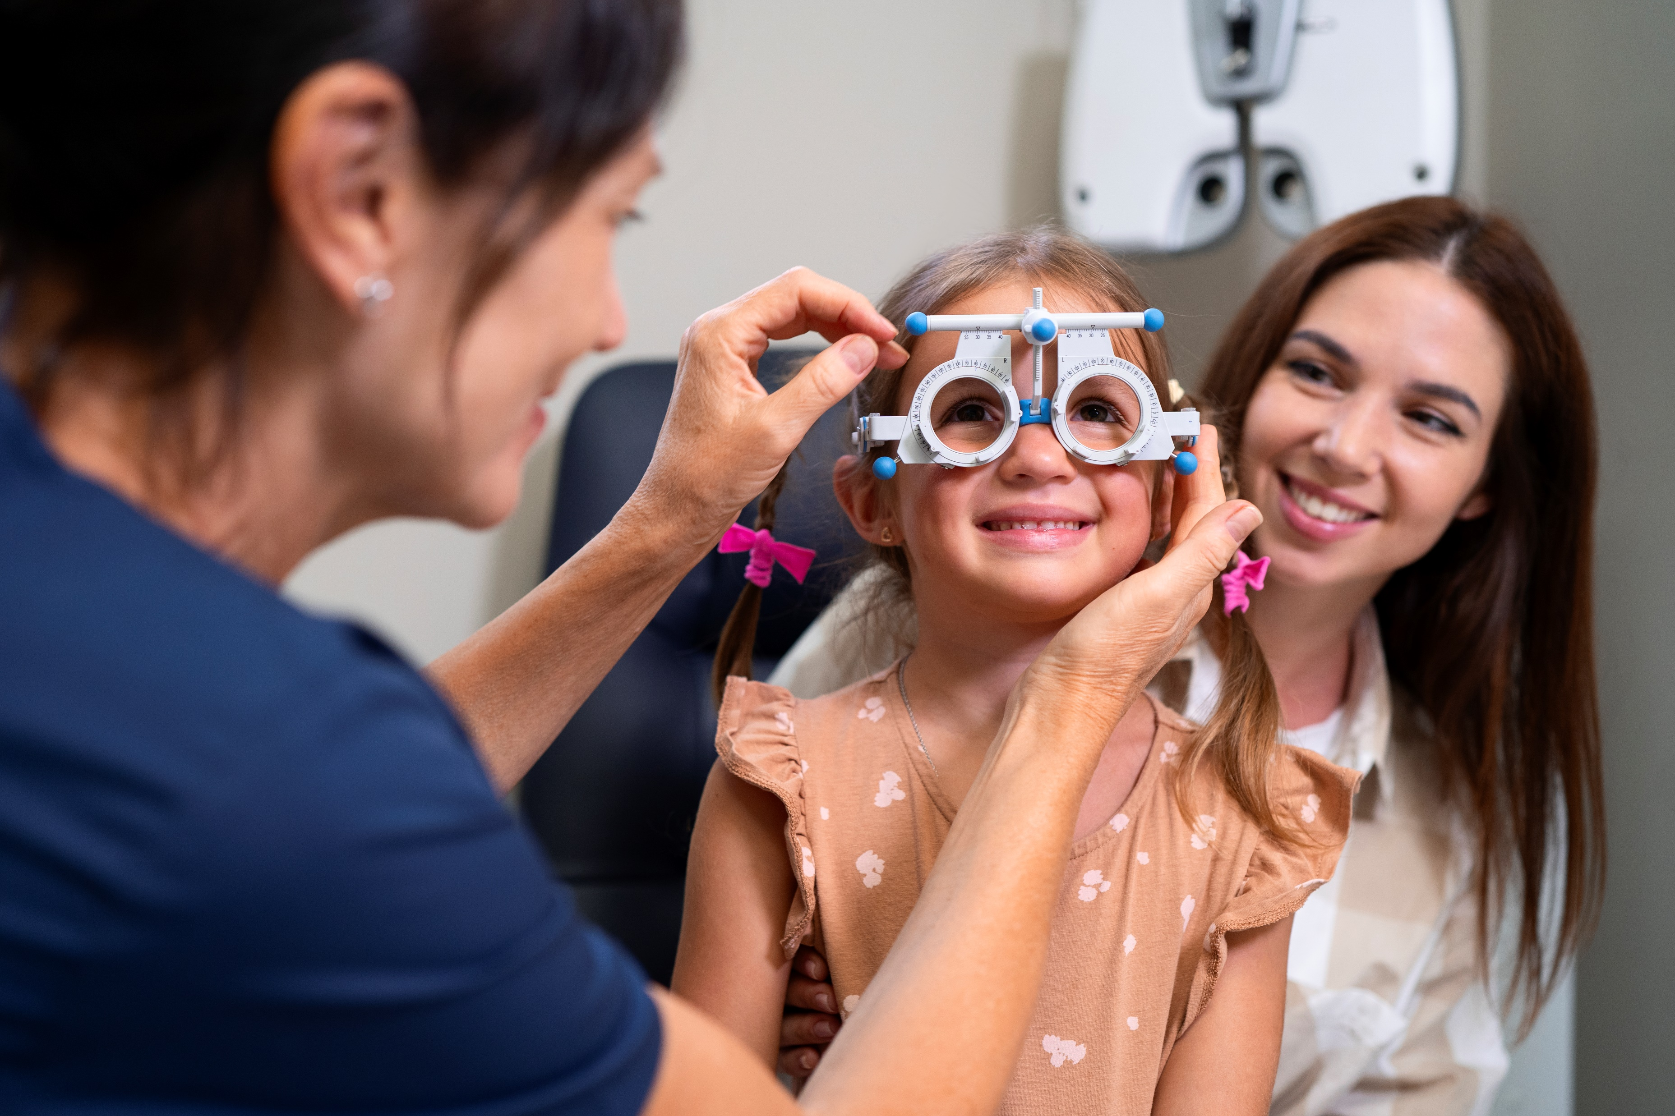
Cloudy Eye (Cataract)
Signs:
White or gray spot in the eye
Not looking at toys or faces
Eyes moving quickly side to side (nystagmus)
Treatment:
Doctors might remove the cloudy lens.
Kids might need special glasses or contact lenses.
हिन्दी (ऑडियो चलाने के लिए आइकन पर क्लिक करें)
Español (Haz clic en el ícono para reproducir el audio)
Notes:
References:
Nihalani BR, Clin Ophthalmol. 2011; PMID: 21845084
Haargaard B, Acta Ophthalmol. 2016; PMID: 26666166
Wilson ME, Community Eye Health. 2003; PMID: 17491934

Slide 29
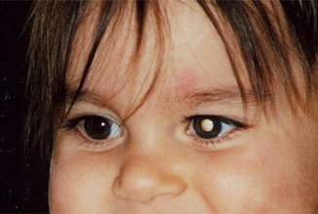
Retinoblastoma
Rare eye cancer in children (usually under 5)
Signs: White glow in pupil, crossed eyes, redness/swelling.
Cause: RB1 gene change (in one or both eyes).
Can be inherited or happen by chance.
Treatment:
Chemo, laser/cryotherapy, sometimes surgery.
Outlook:
Very treatable if found early; genetic testing may be needed.
Early detection is Key.
हिन्दी (ऑडियो चलाने के लिए आइकन पर क्लिक करें)
Español (Haz clic en el ícono para reproducir el audio)

Slide 30
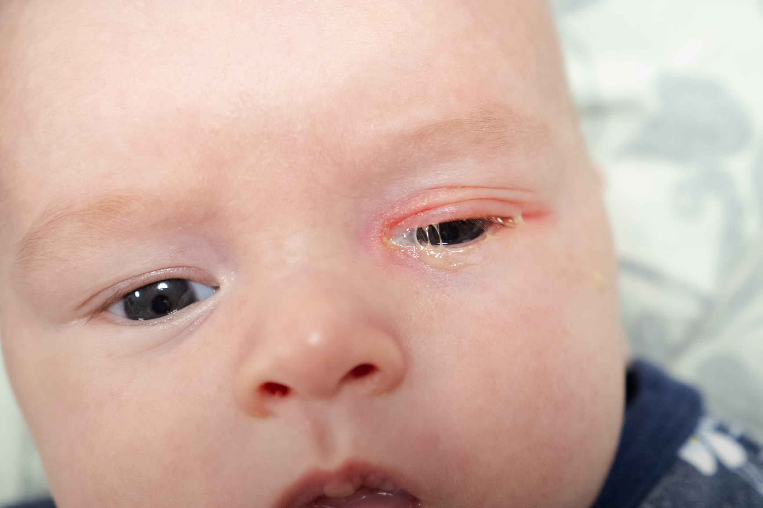

Watery Eyes (Blocked Tear Duct)
What Is a Blocked Tear Duct?
Tears don’t drain.
The eye stays watery.
Signs
Tears all the time
Redness, swelling
Eye gets sticky or crusty
How Do Doctors Fix It?
Parents can gently massage the corner of the eye
Sometimes a small surgery if it doesn’t open by itself
हिन्दी (ऑडियो चलाने के लिए आइकन पर क्लिक करें)
Español (Haz clic en el ícono para reproducir el audio)
Notes:
References:
MacEwen CJ, Eye (Lond). 1991; PMID: 1751467
PEDIG, Ophthalmology. 2005; PMID: 15745786
Paul TO, J Pediatr Ophthalmol Strabismus. 1994; PMID: 7862791

Slide 31

Protecting Your Child’s Vision
Parent & Caregiver Education
हिन्दी (ऑडियो चलाने के लिए आइकन पर क्लिक करें)
Español (Haz clic en el ícono para reproducir el audio)

Slide 32

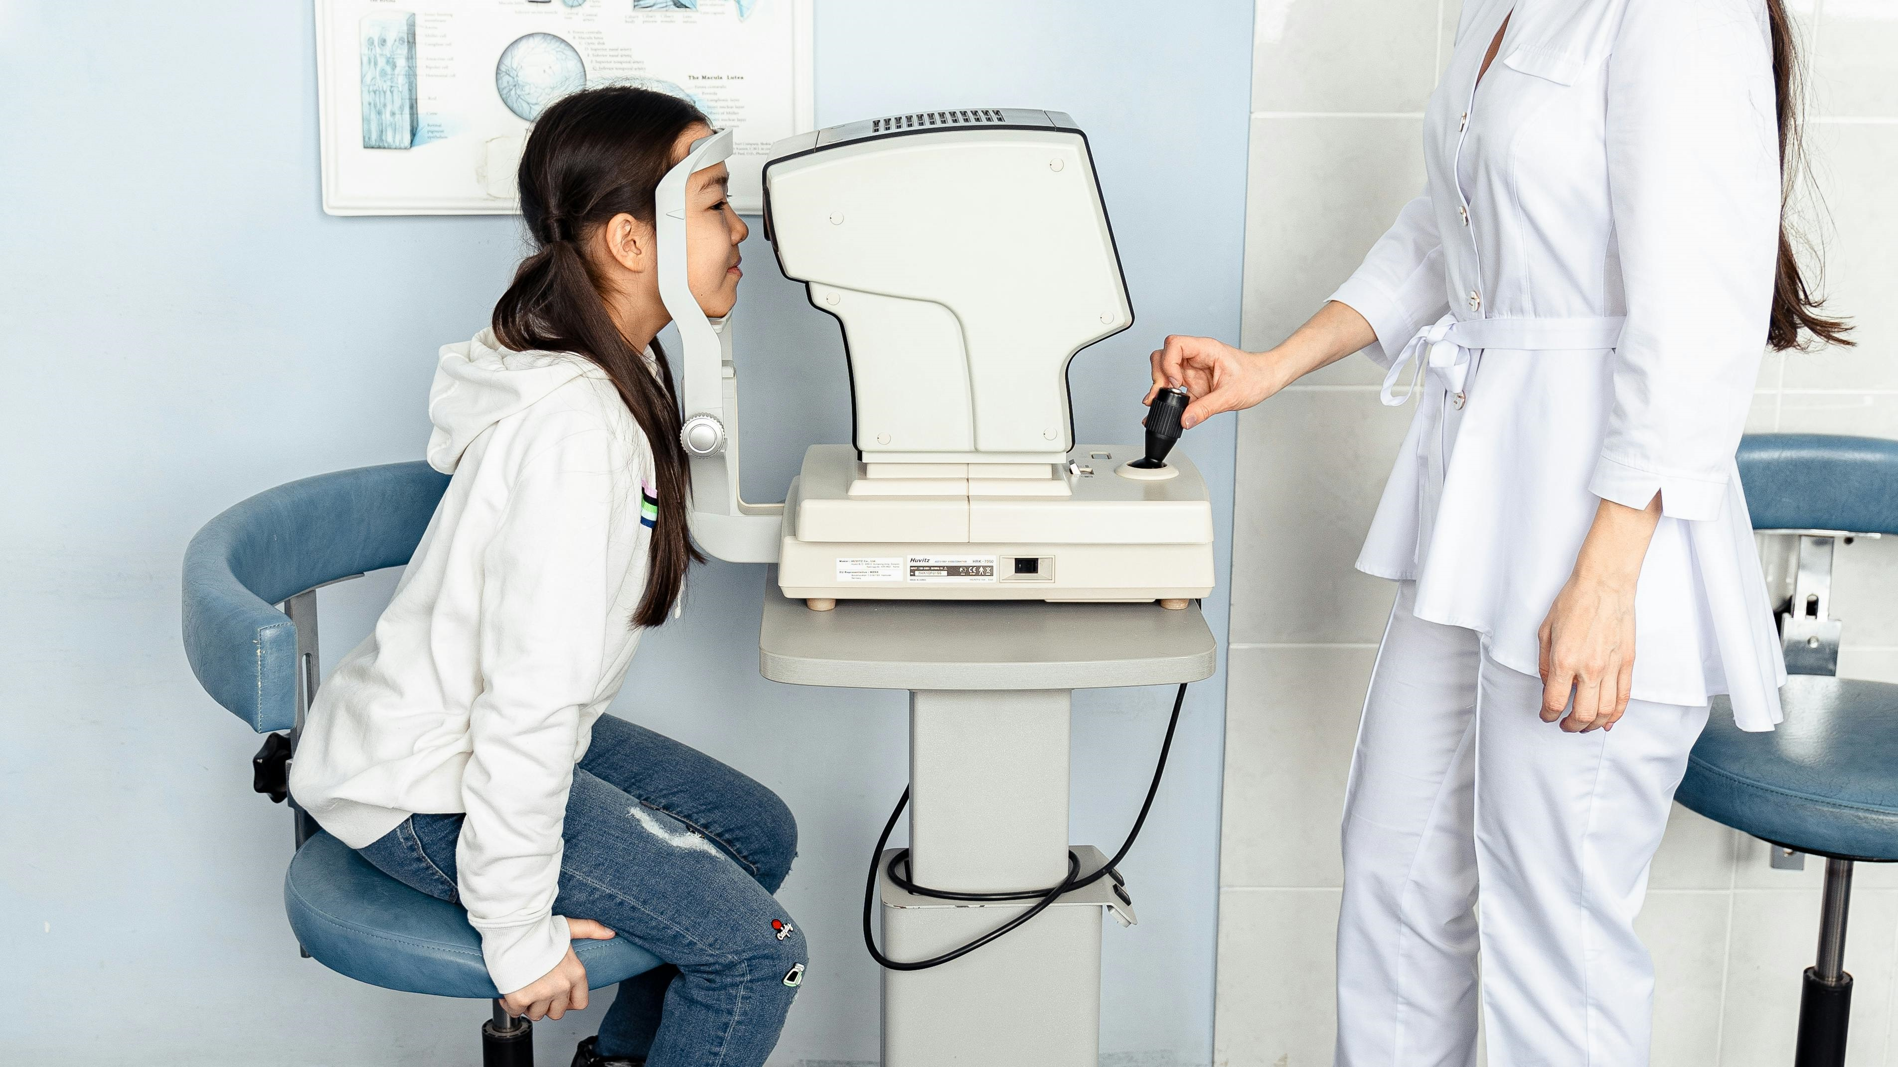
Importance of Regular Eye Exams
Recommended Schedule for Eye Exams:
First eye exam at 6–12 months
Again at age 3, then before school
Every 1–2 years after, or as recommended
What to Expect During an Eye Exam:
Vision testing with eye charts
Checking eye alignment and movement
Assessing overall eye health
हिन्दी (ऑडियो चलाने के लिए आइकन पर क्लिक करें)
Español (Haz clic en el ícono para reproducir el audio)

Slide 33

Limiting Screen Time
Guidelines for Screen Time:
Ages 2–5: Max 1 hour/day of high-quality content
Ages 6+: Set consistent limits and encourage breaks
Tips for Reducing Eye Strain:
Follow the 20-20-20 rule (every 20 minutes, look 20 feet away for 20 seconds)
Ensure proper lighting and screen distance
हिन्दी (ऑडियो चलाने के लिए आइकन पर क्लिक करें)
Español (Haz clic en el ícono para reproducir el audio)

Slide 34

Encouraging Outdoor Activities
Benefits of Outdoor Play:
Natural light helps reduce risk of myopia
Encourages physical activity and eye coordination
Suggested Activities:
Nature walks, sports, playground time
Biking, gardening, or simply playing outside
हिन्दी (ऑडियो चलाने के लिए आइकन पर क्लिक करें)
Español (Haz clic en el ícono para reproducir el audio)

Slide 35

Nutrition for Eye Health
Key Nutrients for Vision:
Vitamin A: Essential for night vision
Lutein and zeaxanthin: Protect against eye damage
Omega-3s: Support retinal development
Foods to Include in Your Child’s Diet:
Carrots, spinach, kale, eggs, fish, oranges
Limit processed snacks and sugary drinks
हिन्दी (ऑडियो चलाने के लिए आइकन पर क्लिक करें)
Español (Haz clic en el ícono para reproducir el audio)

Slide 36

Protective Eyewear
Importance of Sunglasses:
Protects against harmful UV rays
Reduces risk of cataracts and eye damage later in life
Reduces the risk of skin cancer later in life
Safety Goggles for Sports and Activities:
Prevent injuries during sports like basketball or racquetball
Use during science experiments or activities with flying debris
हिन्दी (ऑडियो चलाने के लिए आइकन पर क्लिक करें)
Español (Haz clic en el ícono para reproducir el audio)

Slide 37

Teaching Good Hygiene Practices
Handwashing Techniques:
Wash with soap and water for at least 20 seconds
Before meals, after playing, after using the bathroom
Avoiding Eye Touching:
Teach kids not to rub eyes with dirty hands
Helps prevent pink eye and other infections
हिन्दी (ऑडियो चलाने के लिए आइकन पर क्लिक करें)
Español (Haz clic en el ícono para reproducir el audio)

Slide 38

Reliable Resources for Childhood Eye Disorders
Trusted Websites and Organizations for Parents & Caregivers
हिन्दी (ऑडियो चलाने के लिए आइकन पर क्लिक करें)
Español (Haz clic en el ícono para reproducir el audio)

Slide 39

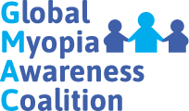


Medical and Health Organizations
Optometrists are often the first line providers and manage most of the conditions especially in diverse populations in the community setting.
aoa.org → Resources on eye exams, myopia, school vision needs, sports safety, and digital screen use
American Optometric Association (AOA) - Children’s Vision
InfantSEE® Program (Optometry Cares – AOA Foundation)
https://infantsee.org
Offers no-cost eye assessments for infants 6–12 months old.
Myopia Awareness - Myopiaawareness.org
Optometrist Network - Optometrists.org
National Center for Children’s Vision and Eye Health- https://nationalcenter.preventblindness.org
हिन्दी (ऑडियो चलाने के लिए आइकन पर क्लिक करें)
Español (Haz clic en el ícono para reproducir el audio)

Slide 40



Medical and Health Organizations
Centers for Disease Control and Prevention (CDC)
  Vision Health Initiative: https://www.cdc.gov/visionhealth
  Offers data, resources, and guidance on child vision health.
National Eye Institute (NEI), NIH
  https://www.nei.nih.gov
  Includes child-focused materials, research updates, and fact sheets.
HealthyChildren.org (American Academy of Pediatrics)
  https://www.healthychildren.org
  Trusted resource for pediatric health, including eye health
हिन्दी (ऑडियो चलाने के लिए आइकन पर क्लिक करें)
Español (Haz clic en el ícono para reproducir el audio)

Slide 41

Vision and Advocacy Organizations
VisionAware (part of the American Printing House for the Blind)Website:
  https://visionaware.org
  Focuses on vision loss and adaptation, but includes pediatric topics too.
Health Diversity Equity & Inclusion Alliance Resources
  https://hdeia.org
  10 Things About Clinical Trials
  Importance of Eye Examinations
हिन्दी (ऑडियो चलाने के लिए आइकन पर क्लिक करें)
Español (Haz clic en el ícono para reproducir el audio)

Slide 42
Recap: Common Childhood Eye Conditions
Refractive Errors: Myopia, Hyperopia, Astigmatism → cause blurry vision
Eye Alignment Issues: Lazy Eye (Amblyopia), Crossed Eyes (Strabismus)
Movement Disorders: Nystagmus (eye shaking)
Infections & Irritations: Pink Eye (Viral, Bacterial, Allergic), Stye
Other Conditions: Cataracts, Ptosis, Blocked Tear Ducts
हिन्दी (ऑडियो चलाने के लिए आइकन पर क्लिक करें)
Español (Haz clic en el ícono para reproducir el audio)

Slide 43
Recap: Protecting Your Child’s Vision
Regular Eye Exams: Early detection is key
Limit Screen Time: Use the 20-20-20 rule
Encourage Outdoor Play: Helps prevent nearsightedness
Nutrition: Include vitamin-rich, eye-friendly foods
Eye Safety: Use sunglasses and sports goggles
Hygiene: Handwashing and avoid rubbing eyes
हिन्दी (ऑडियो चलाने के लिए आइकन पर क्लिक करें)
Español (Haz clic en el ícono para reproducir el audio)

Slide 44

THANK
YOU!
Made possible with a generous donation by:
The Bausch Health Foundation
हिन्दी (ऑडियो चलाने के लिए आइकन पर क्लिक करें)
Español (Haz clic en el ícono para reproducir el audio)
Visit us at www.HDEIA.org

Slide 45
Q and A
1. What’s the difference between a pediatric optometrist and a pediatric ophthalmologist—and which one should my child see?
Explains scope of care: optometrists handle routine vision care; ophthalmologists diagnose and treat complex eye diseases and perform surgery.
2. How much screen time is okay for kids?
For kids ages 2–5, no more than 1 hour per day of high-quality content is recommended. Encourage regular breaks for older kids too
हिन्दी (ऑडियो चलाने के लिए आइकन पर क्लिक करें)
Español (Haz clic en el ícono para reproducir el audio)

Slide 46
Q and A
3. My child’s eyes look crossed sometimes—should I be worried?
Occasional misalignment in very young infants can be normal, but persistent crossing after 4–6 months should be checked by a doctor.
4. Do kids really need sunglasses?
Yes! Sunglasses protect their eyes from harmful UV rays, just like sunscreen protects their skin.
हिन्दी (ऑडियो चलाने के लिए आइकन पर क्लिक करें)
Español (Haz clic en el ícono para reproducir el audio)

Slide 47
Q and A
5. Can my child outgrow farsightedness or nearsightedness?
Some mild farsightedness may improve with age, but nearsightedness (myopia) usually gets worse as children grow.
6. Is it okay for my child to wear blue light glasses?
Blue light glasses are not harmful and may help with screen comfort, but they aren't a substitute for good screen habits
हिन्दी (ऑडियो चलाने के लिए आइकन पर क्लिक करें)
Español (Haz clic en el ícono para reproducir el audio)

